Slide 1


Effective Learning
Goldrick, M (2008)
Unit 4: Exam revision and anxiety

Slide 2
Don’t Panic!
For many students exam time is a period of stress, panic and late-night cramming sessions.
There are however certain strategies that can be used to decrease these negative experiences.
This workshop will guide you through these strategies and help you organise a revision strategy as well as some general tips on exams themselves.

Slide 3
Where to start?!!
Gather your existing resources (lecture notes, etc)
Primarily the best place to start your revision is your notes and assignments from the year as they indicate what you have learned already.
It is advisable though to go through your course books again to get back to the original source of the text as you may have missed something first time around or you may be repeating and therefore may only have access to course books.

Slide 4
Step 1: Creating a revision strategy
Gather all relevant material together for each exam subject
Lecture notes
Course Books
Industrial
Sociology
Past exam papers
Other relevant books

Slide 5
Step 2: Outline an approach
Each subject may require some particular attention or approach but the following practices can be considered near universal study strategies;
SQRNR (Survey, Question, Read, Note-make, Revise
which would be quite similar to the SQ3R method (See Student Support, 2008, p31)
Past-paper mock testing
Group revision

Slide 6
SQRNR
Survey: Approach your course books chapter by chapter and make initial notes of headings, introduction, content and conclusions.
Question: Using this information create questions about the chapter (turn headings and subheadings into questions).
Read: Read the chapter with intent to answer the questions you have created.
Note-make: Create notes about the chapter, focusing on the answers to your questions as well any specific theories or events not addressed by your questions.
Revise: Using each chapters’ notes revise the course

Slide 7
Note-making Tips
When creating notes for revision try to diversify how you display your content as sometimes the diversity can help you recall more easily. For instance for a theory or a person use both the Cornell method and Spider-diagram method to display your information and see which you prefer;
Role-meshing
Irving Goffman | Asylum studies (1960’s), Highlighted stigma issues
Freidrich Nietzsche | Highlighted the need to re-evaluate all values.
Stigma
Asylums
Goffman
When recording answers to questions use the Cornell method as it will best reflect the tone of your answer.

Slide 8
Past-paper mock testing
Once you have created an array of notes (paper, print, audio/visual) you should be well prepared to start analysing some past exam papers.
Use these papers to create exam-like scenarios and set yourself time limits to answer questions.
Try to construct you own possible exam questions (you just might end up practicing your future exam)..

Slide 9
Group revision
Group sessions are a great source of gaining another person’s perspective on an exam question.
Try swapping mock exam answers with your friends and see what they think of your answers and vice versa.
For any off-campus students who wish to interact with other students, an on-line group session can be arranged through a virtual classroom

Slide 10
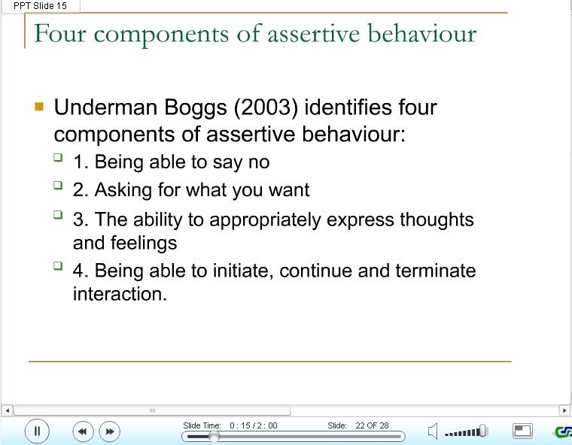
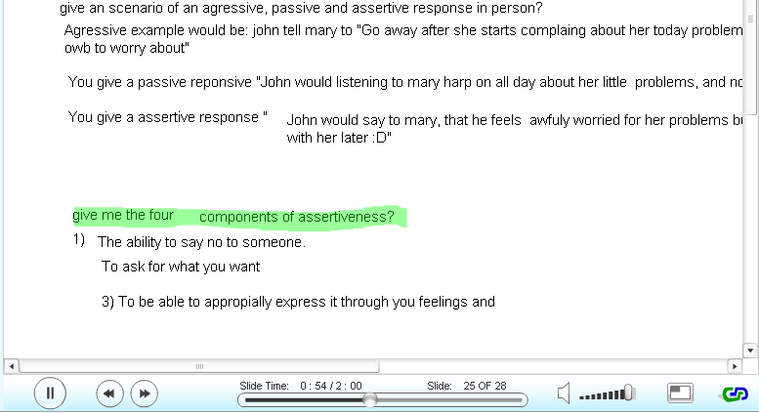
Using Virtual classrooms
A virtual classroom can replicate the real life experience of being at college. Whether used as a group study tool or used for distance learning, the VC is becoming widely used in many major universities.
Talk through lecture slides or notes with classmates
Interactive whiteboard

Slide 11
Some exam tips
The more organised you are the better you will do!
Examiners want to see 4 main skills;
Description: Content, Knowledge of models, tools and theories
Analysis: Why? Why not? Cause and effect. Reasons.
Evaluation: Pro’s and con’s Advantages and disadvantages.
Synthesis: Structure, flow, logic. Making arguments. Use of data.
(adopted from Student Support, 2008, p32)
Read the question carefully, be clear on what it is asking you to do
Be aware of how much time to allocate to each question.

Slide 12
Stress reduction and exam anxiety
Every person feels nervous going into an exam, it is unavoidable. There are however some Do’s and Don’ts to help you through the process;
Do leave your home early, you don’t want to be late.
Do eat some food, your brain needs the energy.
Do think positive; visualise yourself passing the exam
Don’t attempt any heavy revision at the last minute..
Don’t try to overcome anxiety with alcohol
And finally…utilise the BodyMind relaxation programme on page 33!

Slide 13
Some homework?!
Try out the speed reading techniques on page 27-29 of your manuals.
See will the exercises help you become a faster reader.
And finally…

Slide 14
Thank you!

Slide 15
References
Student Support (2009) learning Development Manual. National College of Ireland.

